Slide 1


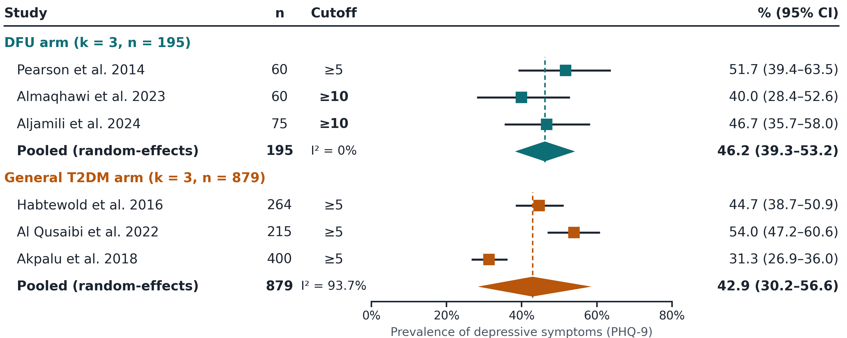
Clinically Meaningful Depressive Symptoms on the PHQ-9 in Patients with Diabetic Foot Ulcers vs. the General Type 2 Diabetes Population: A Systematic Review and Meta-Analysis
Savannah Santiago, DPM¹; Brandon Brooks, DPM, MPH²; Bradley Brooks, DO³; Daniel Powell, MD⁴; Gary Rothenberg, DPM⁵; Michelle Butterworth, DPM⁶; Amanda Killeen, DPM⁷; Lee Rogers, DPM⁸; Ashley Nettles, DPM²; Michael Smyth, MD²; Levi Brooks⁹; David G. Armstrong, DPM, MD, PhD¹⁰
¹ Resident Physician, Ascension St. Vincent Podiatry Residency Program, Indianapolis, IN; ²Columbia VA Health Care System, Columbia, SC; ³University of South Alabama Health, Mobile, AL; ⁴MedStar Georgetown University Hospital, Washington DC; ⁵University of Michigan, Ann Arbor MI; ⁶Medical University of South Carolina, Kingstree SC; ⁷University of Texas - RGV School of Podiatric Medicine, Harlingen TX; ⁸University of Texas Health Science Center at San Antonio, San Antonio, TX; ⁹ Independent Researcher, Columbia, SC; ¹⁰Keck School of Medicine of USC, Los Angeles, CA
Purpose/Introduction
Results
Discussion
Diabetic foot ulcers (DFU) carry a substantial psychological burden, but PHQ-9–measured depression has never been systematically compared between patients with DFU and the general type 2 diabetes (T2DM) population.¹
Nearly 1 in 2 patients with a diabetic foot ulcer screened positive for depressive symptoms.
Depressive symptoms were highly prevalent in both populations, with nearly half of patients with DFU screening positive on the PHQ-9.²⁻⁷ Pooled prevalence was numerically higher with DFU (46.2% vs. 42.9%), but the indirect comparison was not significant and should be considered hypothesis-generating. The strongest evidence comes from the single direct, adjusted comparison, which found nearly three times the odds of depression with DFU.⁸ Two of three DFU studies used the stricter PHQ-9 ≥10 cutoff, so threshold choice is unlikely to have inflated the DFU estimate.²⁻⁴ The relationship also appears bidirectional: in a prospective cohort of 3,474 patients, depression more than doubled the risk of developing a DFU.⁹ Together, these findings support routine PHQ-9 screening in diabetic foot and limb-preservation clinics, with mental health referral built into the multidisciplinary team.¹⁰
PECO
DFU POOLED PREVALENCE
46.2%
95% CI 39.3–53.2%
k = 3 · n = 195 · I² = 0%
GENERAL T2DM POOLED
42.9%
95% CI 30.2–56.6%
k = 3 · n = 879 · I² = 93.7%
DIRECT, ADJUSTED COMPARISON
2.94×
odds of depression with DFU (95% CI 1.82–4.76)
Elnaem et al. 2025 · n = 606
Population: Adults with type 2 diabetes
Exposure: Active diabetic foot ulcer
Comparator: General T2DM population without DFU
Outcome: Clinically meaningful depressive symptoms (PHQ-9)
Methods
Clinical Implications
We searched four databases through July 2026 and pooled PHQ-9 prevalence data from six studies (three DFU, n = 195; three general T2DM, n = 879) using random-effects meta-analysis.²⁻⁸ Pooled prevalence of clinically meaningful depressive symptoms was 46.2% (95% CI, 39.3–53.2%) with DFU and 42.9% (95% CI, 30.2–56.6%) in general T2DM. The indirect comparison was not statistically significant (OR 1.24; 95% CI, 0.91–1.70), but the only direct, adjusted study found nearly three times the odds of depression with DFU.⁹ Nearly half of patients with DFU screen positive for depression, which supports routine PHQ-9 screening in diabetic foot care.
Search: PubMed/MEDLINE, PubMed Central, ScienceDirect, Google Scholar; inception to July 2026
Included: peer-reviewed, English-language studies of adults with T2DM with extractable PHQ-9 prevalence
Quality: Modified Newcastle–Ottawa Scale (0–10)
Analysis: random-effects meta-analysis of logit proportions (DerSimonian–Laird); I²; leave-one-out sensitivity; indirect comparison of arms
Build routine PHQ-9 screening into diabetic foot and limb-preservation clinics.
Create referral pathways; consider consultation-liaison psychiatry on the multidisciplinary team.
Limitations
Only 3 studies per arm; arms compared indirectly
Mixed PHQ-9 cutoffs (≥5 vs. ≥10) not harmonizable
Mostly small, single-center, cross-sectional studies.
Conclusions
Nearly half of patients with DFU screen positive on the PHQ-9. Depression screening belongs in diabetic foot care; adequately powered multicenter studies with standardized PHQ-9 thresholds are needed.
~160
Records identified
Figure 2. PHQ-9 depressive-symptom prevalence by study with random-effects (DerSimonian–Laird) pooled estimates. Dashed lines mark each arm’s pooled value; bold cutoffs are the stricter PHQ-9 ≥10.
42
Full-text articles assessed
10
Studies in narrative synthesis
Indirect comparison
Pooled DFU vs. pooled T2DM: OR 1.24 (95% CI 0.91–1.70). Favors a higher burden with DFU, but the interval crosses 1: hypothesis-generating only.
PHQ-9 cutoffs matter
2 of 3 DFU studies used the stricter ≥10 cutoff; all 3 T2DM studies used ≥5. A stricter bar lowers measured prevalence, so the DFU arm was not advantaged.
Risk of Bias Assessment
The six included studies ranged from 7 to 9 out of 10 via the Modified Newcastle-Ottawa Scale (ratings of fair to good).
References
1. Brooks LM, Brooks BM, Arp AS, et al. Diabetes-Related Extremity Amputation Depression and Distress (DREADD): A Multimethod Study. Semin Vasc Surg. 2025;38(1):94-100. doi:10.1053/j.semvascsurg.2025.01.002
2. Pearson S, Nash T, Ireland V. Depression symptoms in people with diabetes attending outpatient podiatry clinics for the treatment of foot ulcers. J Foot Ankle Res. 2014;7(1):47. doi:10.1186/S13047-014-0047-4;PAGE:STRING:ARTICLE/CHAPTER
3. Almaqhawi A, Morrison AE, Berrington R, Kong MF. Anxiety and depression among patients attending a multidisciplinary foot clinic. Practical Diabetes. 2023;40(2):14-18a. doi:10.1002/PDI.2444;WGROUP:STRING:PUBLICATION
4. Aljamili A, Alyousif L, Barhoush M, Almasoud R. The prevalence of depression among patients with diabetic foot ulcers at King Khalid University Hospital, Riyadh, Saudi Arabia. J Family Med Prim Care. 2024;13(10):4699-4705. doi:10.4103/JFMPC.JFMPC_1824_23
5. Habtewold TD, Alemu SM, Haile YG. Sociodemographic, clinical, and psychosocial factors associated with depression among type 2 diabetic outpatients in Black Lion General Specialized Hospital, Addis Ababa, Ethiopia: a cross-sectional study. BMC Psychiatry 2016 16:1. 2016;16(1):103-. doi:10.1186/S12888-016-0809-6
6. Qusaibi B Al, Mosli H, Kattan W, et al. Depression Among Patients With Type 2 Diabetes Mellitus at King Abdulaziz University Hospital (KAUH): A Cross-Sectional Study. Cureus. 2022;14(6). doi:10.7759/CUREUS.25990
7. Akpalu J, Yorke E, Ainuson-Quampah J, Balogun W, Yeboah K. Depression and glycaemic control among type 2 diabetes patients: a cross-sectional study in a tertiary healthcare facility in Ghana. BMC Psychiatry 2018 18:1. 2018;18(1):357-. doi:10.1186/S12888-018-1933-2
8. Elnaem MH, Bukhori NAS, Tengku TK, Rahayu S, Ramatillah DL, Elrggal ME. Depression and anxiety in patients with type 2 diabetes in Indonesia and Malaysia: do age, diabetes duration, foot ulcers, and prescribed medication play a role? Psychol Health Med. 2025;30(3):555-571. doi:10.1080/13548506.2025.2450545
9. Williams LH, Rutter CM, Katon WJ, et al. Depression and incident diabetic foot ulcers: A prospective cohort study. American Journal of Medicine. 2010;123(8):748-754. doi:10.1016/j.amjmed.2010.01.023
10. Brooks BM, Nettles AM, Brooks BM. Diabetes Psychiatry: The Missing Piece of the Puzzle to Prevent Complications of the Diabetes Pandemic. Psychoactives 2025, Vol 4,. 2025;4(2):13. doi:10.3390/PSYCHOACTIVES4020013
6
Pooled: 3 DFU + 3 T2DM
1
Direct DFU vs. no-DFU
Figure 1. Study selection (PRISMA)

