Slide 1

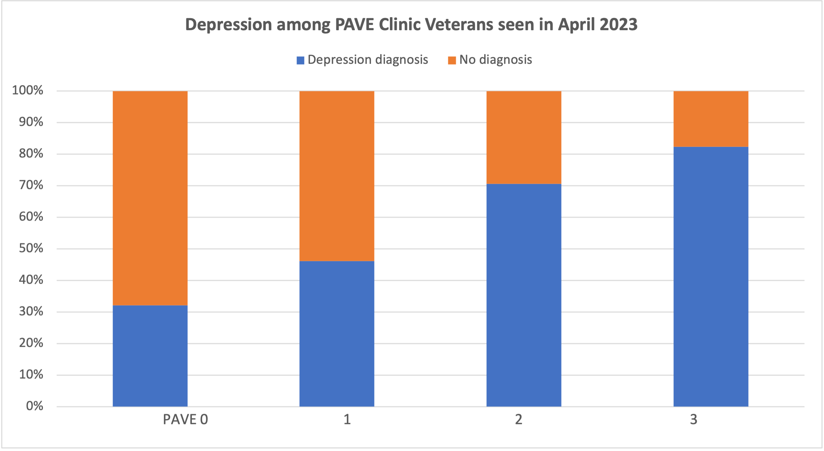
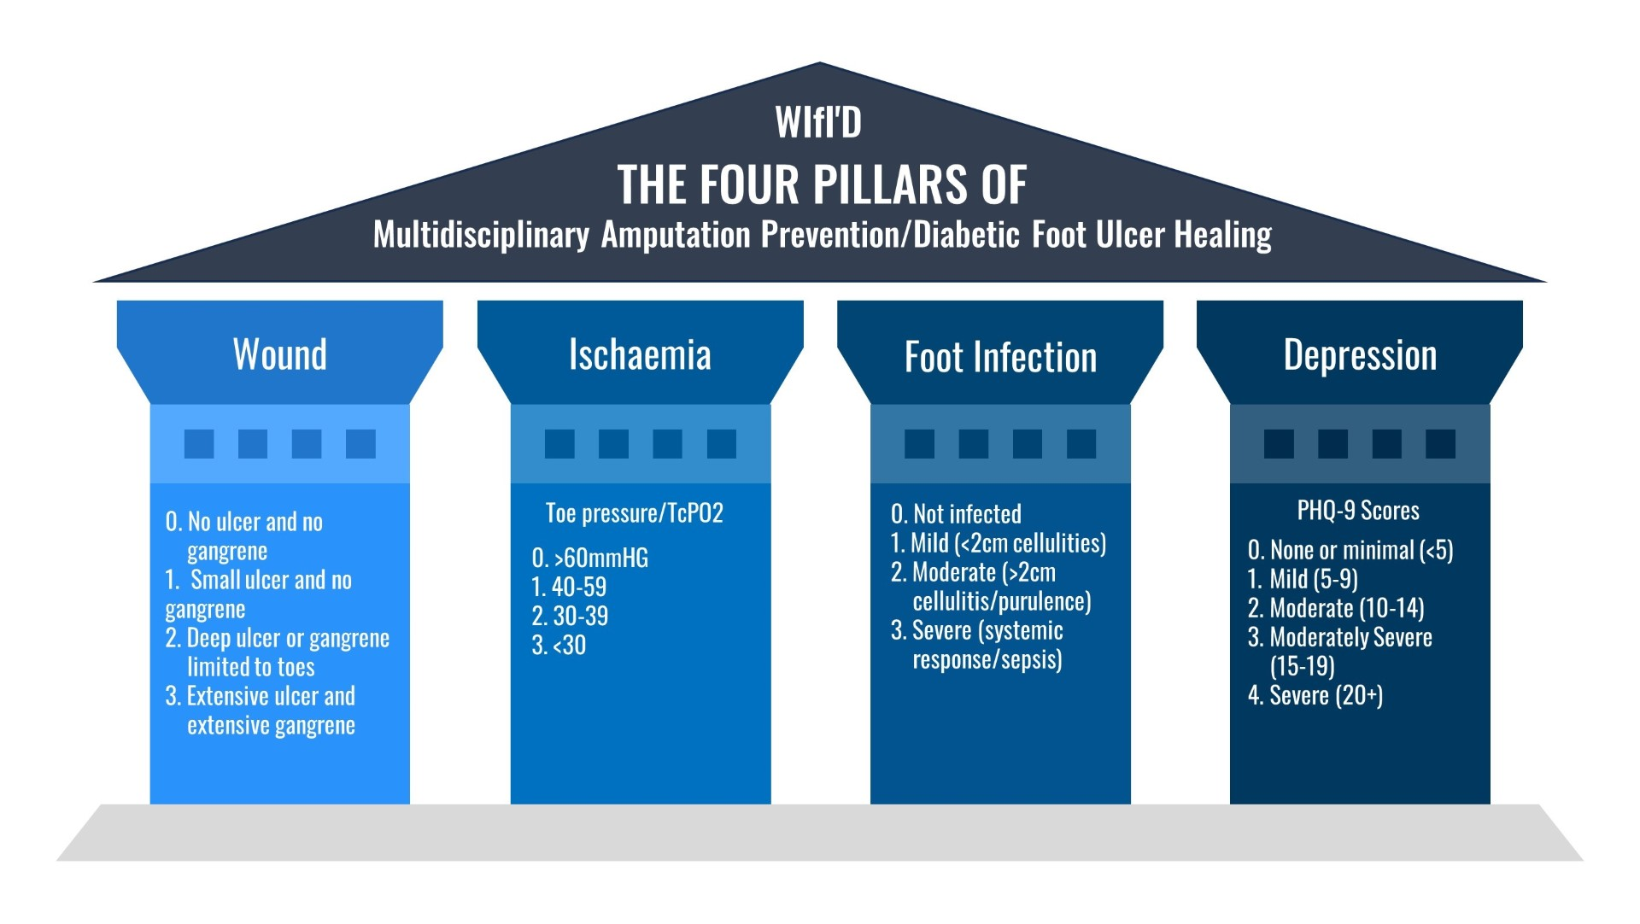
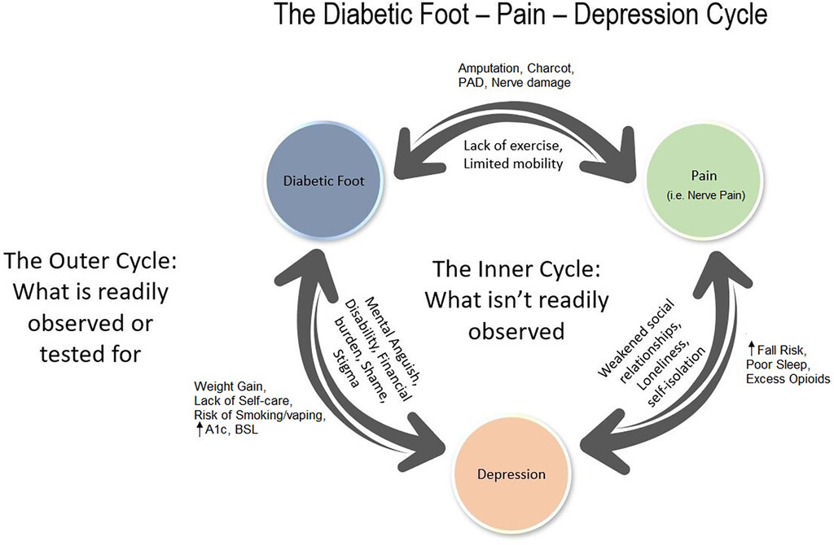
Depression :
The Fourth Pillar of Classifying Risk of Diabetes-Related Amputations in Veterans
Brandon M. Brooks, DPM, MPH¹; Jaminelli Banks, DPM²; Allison Arp, MS³; Vilayvanh Saysoukha, DPM, MS⁴; Bradely M. Brooks, DO⁵; Nichol L. Salvo, DPM⁶; Alton R. Johnson, DPM⁷; Donya A. Rabadi, BS⁸; Lee C. Rogers, DPM¹⁰
¹Dorn VA Medical Center, Columbia, SC ²Center for Limb Preservation Advanced Wound Care, Los Angeles, CA, ³The Dartmouth Institute, Hanover, NH, ⁴Premier Foot and Ankle Centers of TN, McMinnville, TN, ⁵Altapointe Health, Mobile, AL, ⁶Atlanta VA Health Care System, Atlanta, GA, ⁷University of Michigan, Ann Arbor, MI
⁸Western College of Podiatric Medicine, Pomona, CA, ⁹The Well, Sumter, SC, ¹⁰UT Health San Antonio, San Antonio, TX
1 Columbia VA Health System, Columbia, SC; 2 The Dartmouth Institute for Health Policy and Clinical Practice, Hanover, NH; 3 Augusta Foot and Ankle, Augusta, GA; 4 UT Health School of Public Health, Austin, TX; 5 The American Podiatric Medical Association, Bethesda, MD
Purpose
Results
Discussion
Over half of the 100,000 lower extremity amputations in the United States every year are related to complications of diabetes mellitus, yet depression and mental health are not routinely addressed as an underlying contributor. As healthcare continues to shift in the United States to more population-specific and customized preventive measures, it is unknown if threatened limb and other wound classification systems should as well. The Veteran population has unique comorbid, socioeconomic, and psychosocial challenges, including mental health issues secondary to traumatic experiences. In this study, we aim to determine associations between a diagnosis of depression and the PAVE FRS among the Veteran population. Secondarily, we aim to produce a Veteran-specific DFU classification system for this population. We hypothesize that Veterans with a PAVE FRS 2 and PAVE FRS 3 will have greater odds of a diagnosis of depression compared to the PAVE FRS 0. Further, we hypothesize that there will be no significant difference between PAVE FRS 2 and PAVE FRS 3 Veterans in terms of the prevalence of depression.
Descriptive Results
148 veterans met the inclusion criteria.
28 veterans were classified as PAVE FRS 0, 52 were classified as PAVE FRS 1, 51 as PAVE FRS 2, and 17 FRS as PAVE 3.
The diagnosis of depression was broken down by PAVE FRS in Figure 2.
Univariate Analysis
Only PAVE FRS 2 and PAVE FRS 3 were statically significant in the univariate analysis.
Multivariate Logistic Regression Model
The pseudo R-square was 0.0906.
PAVE FRS 0 was the referent group.
Veterans with a PAVE FRS 1 did not have a statistically significant difference (p=0.227) in having a diagnosis of depression compared to veterans with a PAVE FRS 0.
Veterans with a PAVE FRS 2 had greater odds (OR= 5.01; p=0.001; 95%CI 1.87,13.72) of having a depression diagnosis compared to veterans with a PAVE FRS 0.
Even more significant, veterans with a PAVE FRS 3 had even greater odds (OR= 9.85; p=0.002; 0.002;95% CI 2.25,43.18) of having a depression diagnosis compared to veterans with PAVE FRS 0.
Fisher’s Exact Test
We utilized Fischer’s exact test to determine if there was a prevalence of a diagnosis of depression between PAVE FRS 2 and 3. A value of 0.527 indicated no significant difference between PAVE FRS 2 and PAVE FRS 3.
The WHO acknowledged depression as a leading cause of lobal disease burden affecting 280 million people and costing $326.7 billion in 2018 in adults alone.^{2,3} Recommended treatment plans for depression should include a comprehensive approach utilizing psychotherapy, pharmacotherapy, and tailored management for comorbidities.⁴ Early recognitive and appropriate referral is imperative.
Depression has been documented to be associated with noncompliance, self-isolation, failure to keep appointments and hopelessness, all associations that pose significant challenge to wound healing.
In this retrospective cohort study of 148 Veterans, depression was highly prevalent (30-80% depending on FRS). Further, it is known that both deployment and combat are associated with increased risk of depression.⁵
Current wound care and threatened limb classification systems do no account for depression or overall mental health.
We proposed a modification to the Society for Vascular Surgery’s WIfI (Wound, Ischemia, Foot Infection) Threatened Limb Classification System to include depression (Figure 3).
We recommend podiatrists use Patient Health Questionnaire-9 (PHQ-9), a nine-question instrument to screen for depression and make appropriate referrals to mental health clinicians (i.e., psychiatrists, clinical psychologists).
Introduction
Limitations
PAVE Program
Implemented by the Veterans Association nationwide, Prevention of Amputation in Veterans Everywhere or PAVE is a risk classification system based that stratifies patients based on neuropathy, vascular disease, physical deformities, and other comorbidities.
Veterans are evaluated and assigned foot risk scores (FRS).
PAVE FRS scale: PAVE FRS 0 = normal risk. PAVE FRS 1 = Deformity PAVE FRS = 2 decreased sensation, no severe peripheral arterial disease, no ulceration, and no CKD or less than CKD stage 4. PAVE FRS3 = history of DFU, amputation, severe peripheral arterial disease, Charcot with lasting foot deformity, or CKD stage 4.
Diabetic Foot Complications and Depression
The causes of diabetic foot ulcers in veterans are multifactorial and preventable ranging from poor diet, lack of exercise, and depression.
Depression is associated with poor wound healing contributors such as emotional eating, poor diet, lack of compliance, self- isolation and substance abuse.
The diabetic foot-pain-depression cycle first proposed by Brooks et al to described an underlying causal mechanism between depression, pain, and diabetic foot complications (Figure 1).¹
Figure 3: Depression diagnosis (blue) by PAVE FRS
Figure 2: The Four Pillars of Multidisciplinary Amputation Prevention in WIfI’D
Conclusions
Depression is prevalent in the Veteran population; Veterans with a PAVE FRS of 2 or 3 had greater odds of having a diagnosis of depression compared to veterans with a PAVE FRS of 0.
There was no significant difference in prevalence of depression in PAVE FRS 2 (no DFU or amputation) and PAVE FRS 3 (DFU or amputation).
Given that depression is associated with noncompliance, self-isolation, failure to keep appointments and hopelessness, all associations that pose significant challenge to wound healing, we recommend that psychiatrists and other mental health clinicians be included on multidisciplinary limb salvage teams.
We propose a modified WIfI classification system to help both veterans and clinicians overcome the schema associated with routine depression screening.
Figure 1: The Diabetic Foot- Pain – Depression Cycle
Methods
Limitations
References
1. Brooks BM, Shih CD, Brooks BM, et al. The Diabetic Foot-Pain-Depression Cycle. J Am Podiatr Med Assoc. 2023;113(3). doi:10.7547/22-126
2. Moussavi S, Chatterji S, Verdes E, Tandon A, Patel V, Ustun B. Depression, chronic diseases, and decrements in health: results from the World Health Surveys. Lancet. 2007;370(9590):851-858. doi:10.1016/S0140-6736(07)61415-9
3. 26. Depressive disorder (depression). https://www.who.int/news-room/fact-sheets/detail/depression. Accessed May 15, 2023.
4. Gold SM, Köhler-Forsberg O, Moss-Morris R, et al. Comorbid depression in medical diseases. Nat Rev Dis Primers. 2020;6(1). doi:10.1038/S41572-020-0200-2
5. Inoue C, Shawler E, Jordan CH, Jackson CA. Veteran and Military Mental Health Issues. StatPearls. May 2022. https://www.ncbi.nlm.nih.gov/books/NBK572092/. Accessed May 15, 2023.
6. van Netten JJ, Seng L, Lazzarini PA, Warnock J, Ploderer B. Reasons for (non-)adherence to self-care in people with a diabetic foot ulcer. Wound Repair Regen. 2019;27(5):530-539. doi:10.1111/WRR.12728
7. Porges SW. The polyvagal theory: New insights into adaptive reactions of the autonomic nervous system. Cleve Clin J Med. 2009;76(Suppl 2):S86. doi:10.3949/CCJM.76.S2.17
8. Cooper CM, Farrand AQ, Andresen MC, Beaumont E. Vagus nerve stimulation activates nucleus of solitary tract neurons via supramedullary pathways. J Physiol. 2021;599(23):5261-5279. doi:10.1113/JP282064
We obtained expedited approval from the Dorn VA Medical Center’s Institutional Review Board for retrospective cohort study design.
Our population of interest were veterans enrolled in the PAVE Clinic at the Dorn VA Medical Center. All PAVE patient charts from April 2023 were reviewed.
We used simple logistic regression for the univariate analysis and all explanatory variables with p<0.1 were include in the multivariate analysis
Patients without type 2 diabetes mellitus were excluded. Patients with CKD stage 4 and Charcot were excluded.
Explanatory variables were PAVE Foot Risk Score (FRS), BMI, age HbA1c, sex, and race.
The outcome of interest was a documented diagnosis of depression.
The veteran population in one state may not be reflective of the entire American veteran population.
Our sample size (n=148) limits generalizability of results.
Further studies are needed to validate the inclusion of depression/mental health in the WIfI classification system.
DISCLAIMER: The contents do not represent the views of the U.S. Department of Veteran Affairs or the United States Government.

